Slide 1
Hybrid concurrency
The end of Dennard scaling
Notes:
Newer technology
Result of Dennard Scaling
How do I take advantage of disparate hardware on my machine?

Slide 2


Types of concurrency
We have explored two types of concurrency
  Thread-based
  Process-based
 | Thread | Process
No concurrency
Thread-based
Process-based
Hybrid
Notes:
Uses both thread and processes!

Slide 3
Hybrid concurrency
Hybrid concurrency uses the available hardware resources in the most efficient manner.
  Use process-based concurrency (e.g. MPI) to execute one fat process on each node //not used as commonly
  Use thread-based concurrency (e.g. task-based algorithms) inside each process
  Use special hardware on each node
    Graphics Processing Unit (GPU)
      NVIDIA
      AMD/ATI
    Many Integrated Core (MIC)
      Intel

Slide 4
GPU Programming
A number of different extensions and standards exist for GPU programming.
  CUDA
    Developed by NVIDIA
    Latest NVIDIA cards have ~2600 processors
      * floating point done very well
  OpenCL
    Open standard for GPU development
    Supported by NVIDIA, AMD, Intel
      Started by AMD
  C++ AMP
    Microsoft standard competing with OpenCL
      Integrated into Visual Studio

Slide 5
Characteristics of GPU programming
All of the these GPU programming standards share common characteristics.
  Special compilers
  Custom libraries (e.g. memory management)
  Special compiler directives
  GPUs do not execute not x86 or x64 code
Why?
  GPUs are not good at general purpose computing
  Tend to support only inline execution, have shorter pipelines, slower clock speeds
  Very good for floating point math
    Terrible for most everything else
      Most other types of processes does predictive execution

Slide 6
Application Architecture
Taking advantage of a GPU requires specific application architecture.
  Find code that is highly parallel (Amdahl's Law)
  Find processor-bound algorithms
    Cost to move memory to and from the GPU
    Cost of more complex source code
  General purpose code will suffer when executed on the GPU
  Offload model – executable runs on host, sections of code run on GPU
Bottom line: Code needs to be written for the GPU (there is still no free lunch)

Slide 7
Using a GPU with offload
Host
Computation
CPUs
GPU 1
Memory copy
CPU 1
CPU 2
GPU 2
CPU 3
CPU 4
Memory copy

Slide 8
Intel Many Integration core
Intel’s entry in this market is the Many Integrated Core (MIC) architecture. (Late entry)
  Xeon Phi is the first MIC product released
    60 general-purpose CPUs, four threads per CPU
      Similar to Atom processors
      Execute general-purpose x86, x64 code
      No out of order execution
      512-bit wide registers (multiple floating point instructions in one go)
      Special vector processing unit
    No graphics output – purely an accelerator card
    Runs custom version of Linux on the card
      Can SSH to the card from the host
    Can execute Linux binaries compiled for MIC architecture

Slide 9
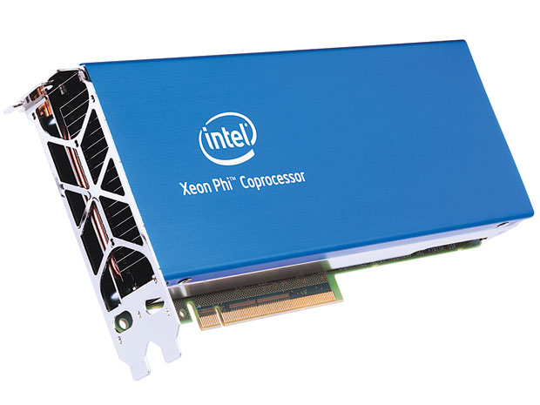
Xeon Phi

Slide 10
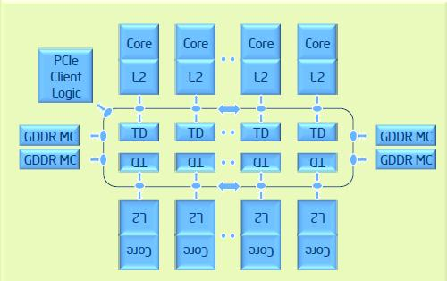
Xeon Phi Architecture
Notes:
60 cores, each with L2 Cache and L1 cache
GDDR MC – memory cache

Slide 11
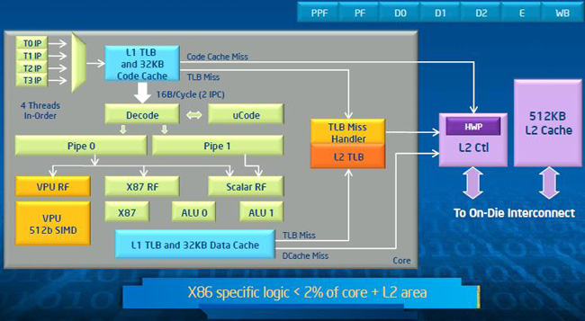
Individual Core Architecture
Notes:
Has special floating-point hardware

Slide 12
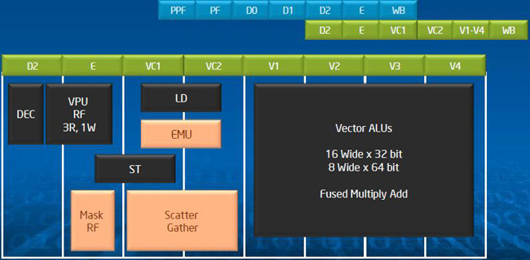
Vector Processing Unit
Notes:
Scatter Gather – built in mapreduce

Slide 13
Programming for the Xeon Phi
Like other GPUs, Xeon Phi supports an offload model.
  Using the Intel C++ compiler, special directives can be added to code.
    For offloading to GPU: memory copy, etc.
  Also supports native compilation
    Compile an entire executable to run only on the Xeon Phi
    No special directives
    Concurrency support for
      Intel MPI
      Open MP
      Intel Cilk Plus extensions
      Intel Threading Build Blocks
  Let’s look at an example
Notes:
Will run on xenon card with NO modifications

Slide 14
Digression: Nash solutions
The algorithm and we will explore categorizes Nash solutions.
  Embarrassingly parallel
  Processor-bound
  Does not do floating point calculations
  Implemented using Threading Building Blocks
Notes:
NOT ON FINAL::
Nash solutions & game theory

Slide 15
Nash algorithm (6x6) on Xeon Data
Number of Threads | Actual Run Time | Linear Scalability
1 | 668.07 | 668.07
2 | 341.61 | 334.04
3 | 232.12 | 222.69
4 | 174.99 | 167.02
5 | 139.35 | 133.61
6 | 116.44 | 111.35
7 | 99.91 | 95.44
8 | 87.43 | 83.51
9 | 77.79 | 74.23
10 | 70.04 | 66.81
11 | 63.47 | 60.73
12 | 58.27 | 55.67
Notes:
EMBARARSINGLY PARALLEL - LINEAR

Slide 16
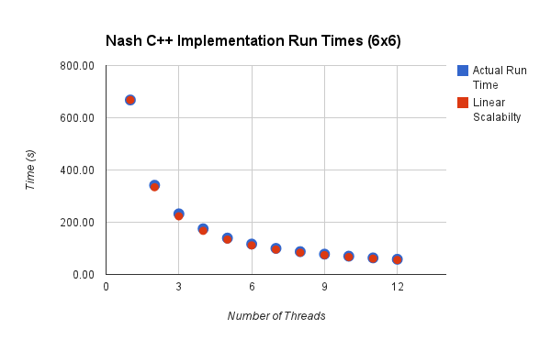
Nash algorithm (6x6) on Xeon

Slide 17
Nash algorithm (6x6) on Xeon Phi Data
Number of Threads | Actual Run Time | Linear Scalability
1 | 4,177.10 | 4,177.10
2 | 2,111.20 | 2,088.55
4 | 1,053.28 | 1,044.27
8 | 534.01 | 522.14
16 | 267.94 | 261.07
32 | 133.46 | 130.53
60 | 71.45 | 69.62
120 | 50.09 | 34.81
240 | 48.02 | 17.40
Notes:
Gets up to 2 threads per core here

Slide 18
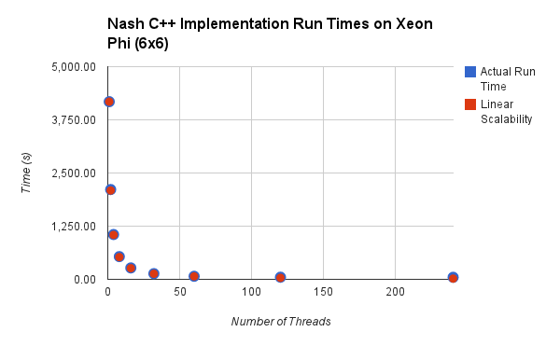
Nash algorithm (6x6) on Xeon Phi

Slide 19
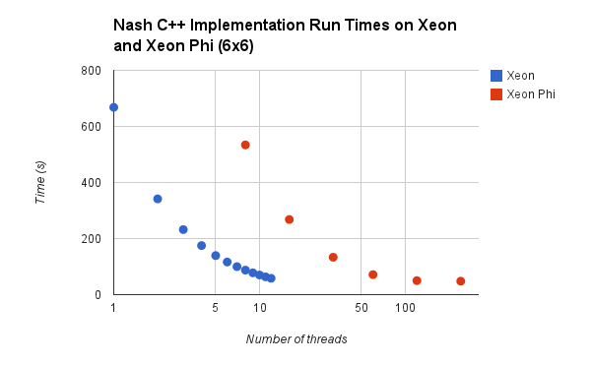
Xeon vs Xeon Phi
Notes:
Once we hit about 60, xeon phi begins to shine

Slide 20
Why is this occurring?
Recall the end of Dennard scaling.
  GPUs exhibit worse performance.
  GPUs exhibit better performance per watt.
The near future:
  More simple, slow GPU cores available
  Improvement in GPU cores for general purpose code
  Faster connection to GPU cores (for improved offload performance)
Notes:
Can do special-purpose work faster

